Slide 1
SDIP Permanent Operable Gates
Objectives:
Minimize movement of in and out-migrating salmon towards the export pumps.
Maintain adequate water levels for South Delta farmers to prevent cavitation of irrigation pumps.
Improve water quality in South Delta channels by providing better flow circulation

Slide 2
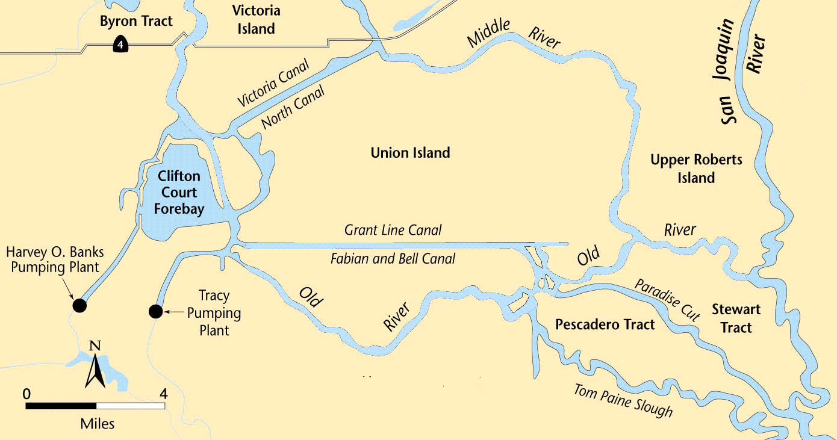
SDIP Permanent Operable Gates
Middle River
Grant Line
Canal
Old River at Tracy Bridge
Head of
Old River
Permanent Operable Gate
Water Level Target
Water Quality Standard

Slide 3
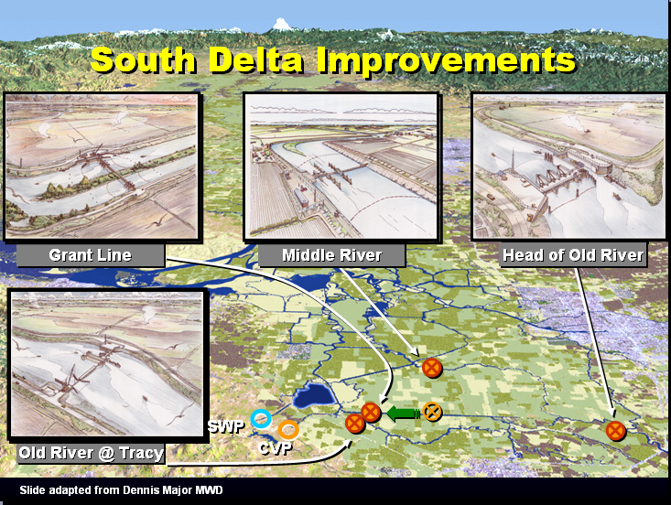

Slide 4
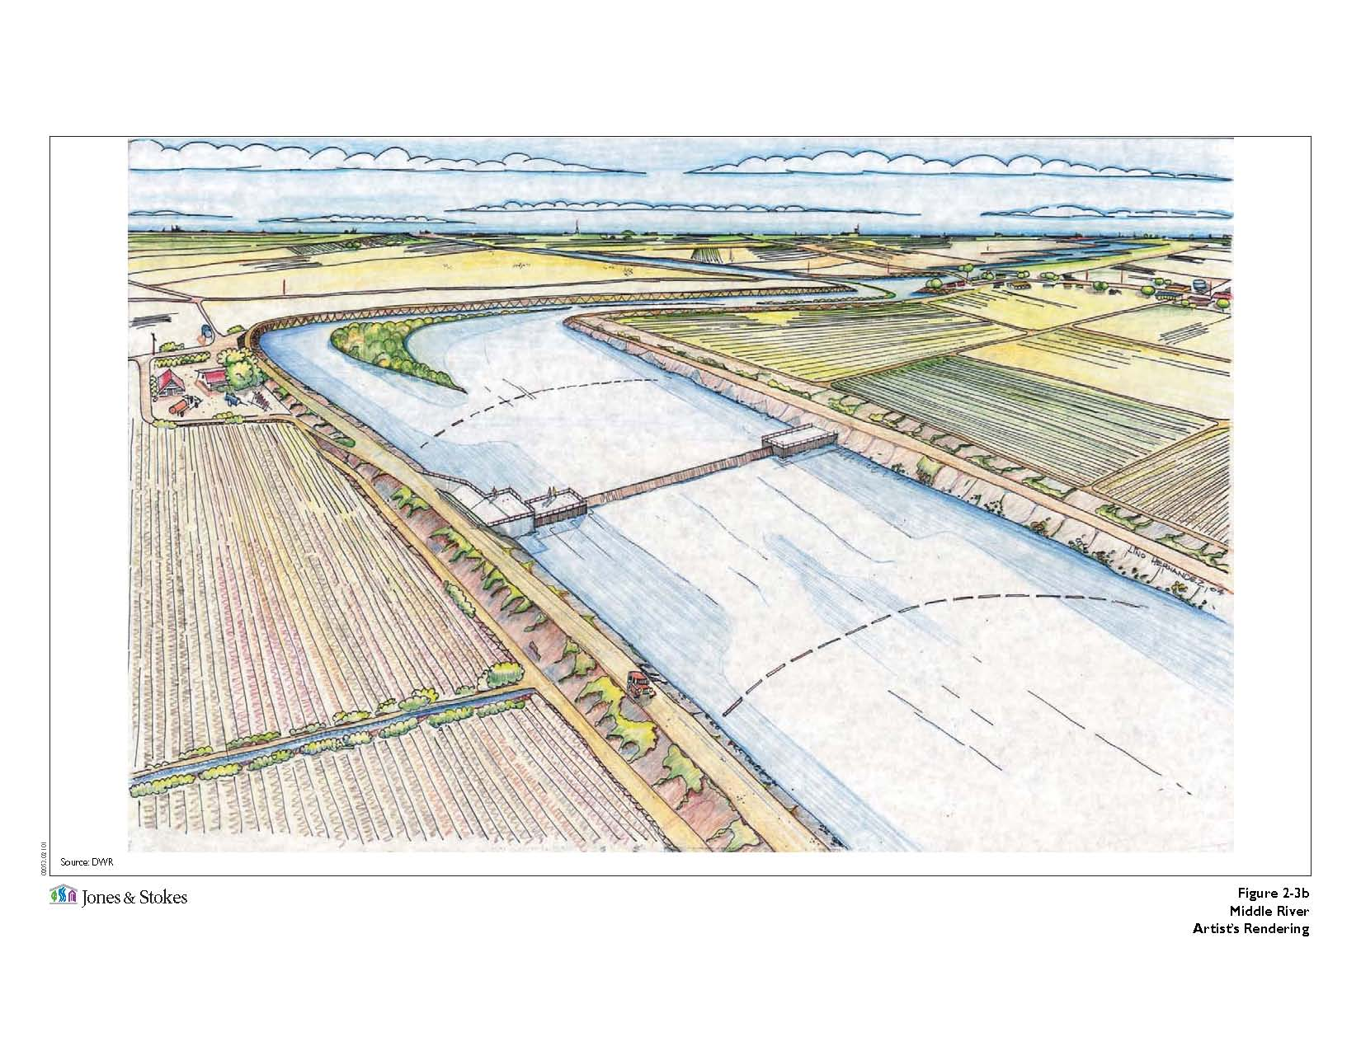
Middle River Gate

Slide 5
Middle River Gate
Type:
Flow Control
Purpose:
Assist in maintaining water levels and water quality for south Delta agricultural users.
Operation:
San Joaquin River flow at Vernalis and water level in Middle
River near Undine Road Bridge control the closing and
opening of the gate.
Open on the flood tide and close on the ebb tide.

Slide 6
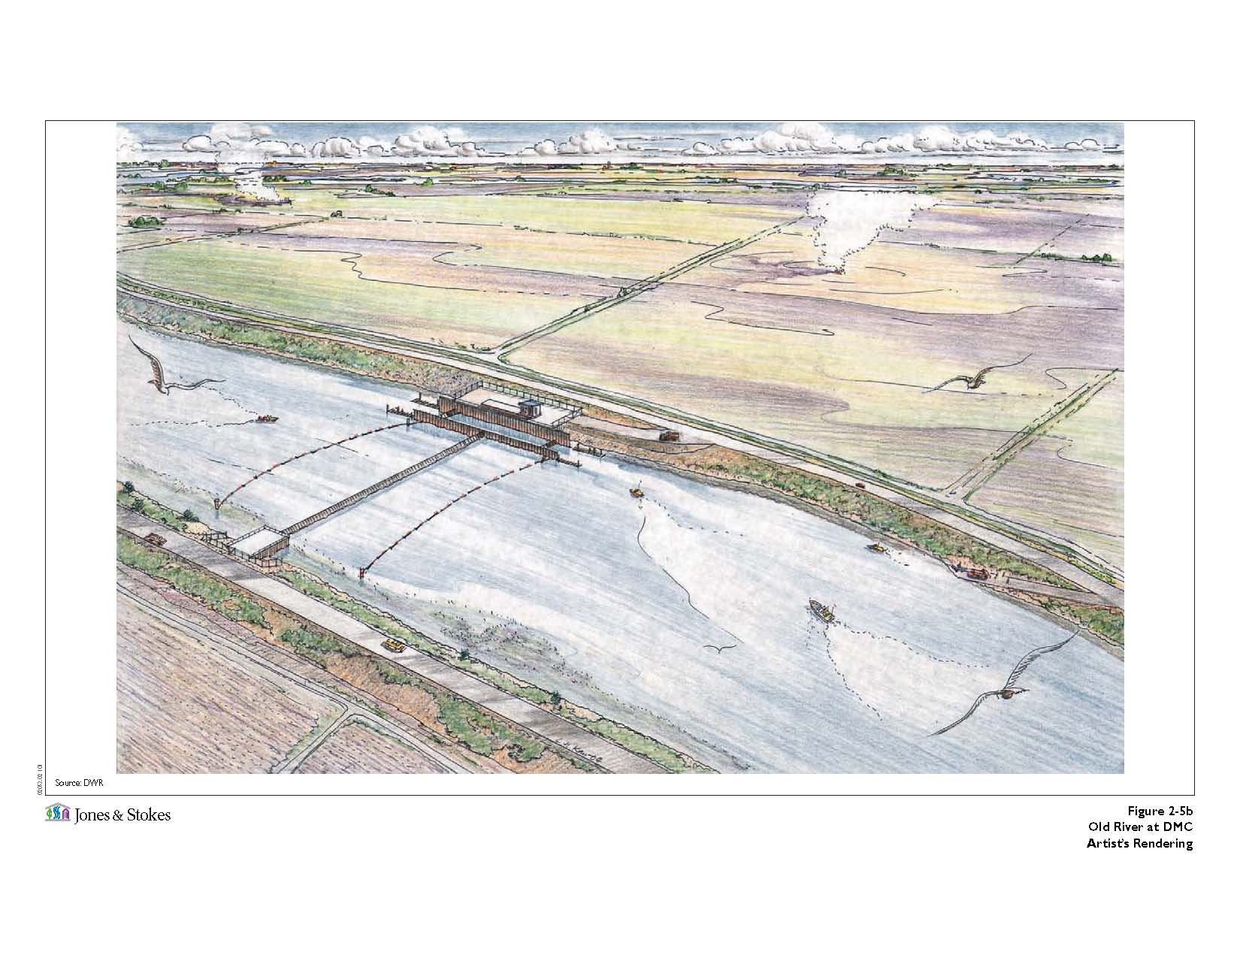
Old River at Tracy Gate

Slide 7
Old River at Tracy Gate
Type:
Flow Control
Purpose:
Assist in maintaining water levels and water quality for south Delta agricultural users.
Operation:
San Joaquin River flow at Vernalis and water level in Old
River near Tracy Road Bridge control the closing and
opening of the gate.
Open on the flood tide and close on the ebb tide.

Slide 8
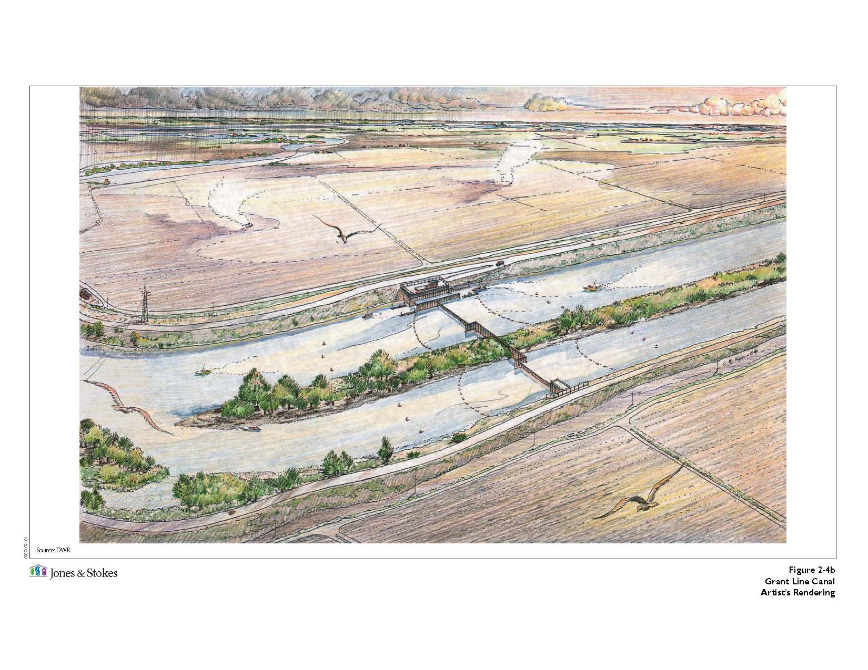
Grant Line Canal Gate

Slide 9
Grant Line Canal Gate
Type:
Flow Control
Purpose:
Assist in maintaining water levels and water quality for south Delta agricultural users.
Operation:
San Joaquin River flow at Vernalis and water level in Grant
Line Canal near Tracy Road Bridge control the closing and
opening of the gate.
Open on the flood tide and also allow water to leave during
the ebb tide.
Inducing circulation to improve water quality.

Slide 10
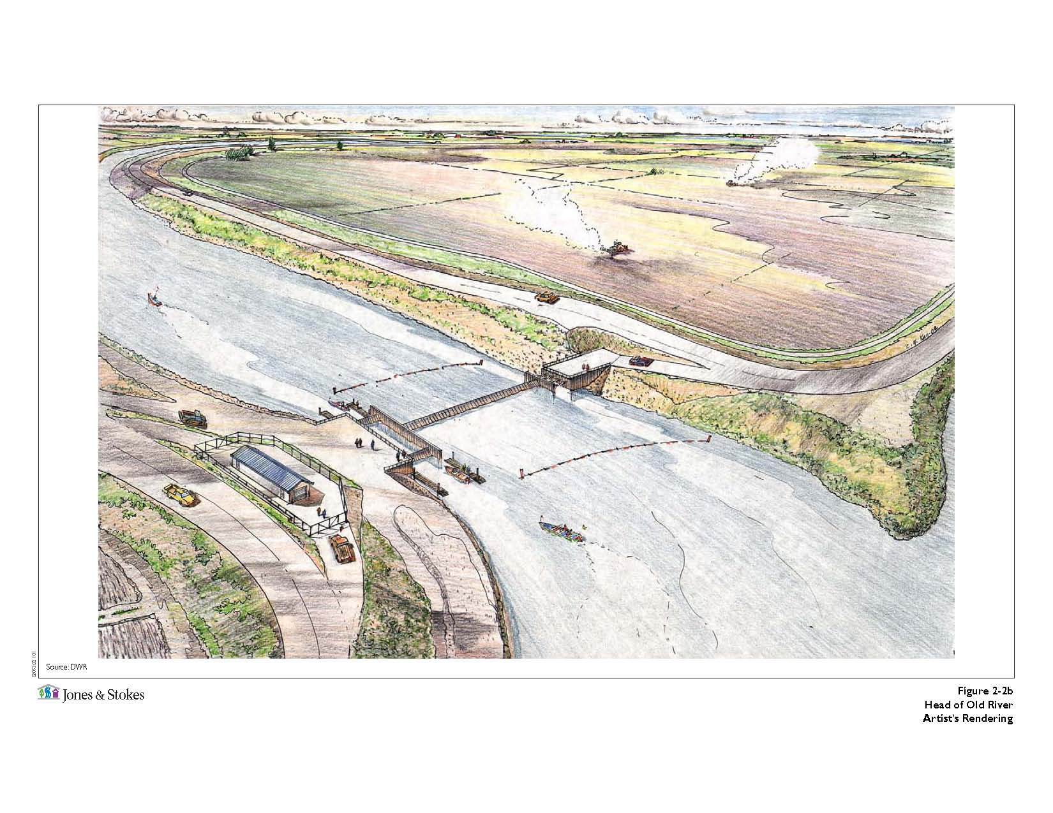
Head of Old River Gate

Slide 11
Head of Old River Gate
Type:
Fish Control
Purpose:
Prevent migrating and out migrating salmon from entering Old River from the San Joaquin River, thus minimizing exposure to the SWP and CVP pumping facilities.
Operation:
San Joaquin River flow at Vernalis control the closing and
opening of the gate.

Slide 12
SDIP Permanent Gates Operation Rules
Operating rules combine Action and Trigger
Action
- The execution of operating rules.
- Expression
“SET model_object TO numerical expression”
Trigger
- Evaluate TRUE or FALSE
- Expression:
“chan_stage (channel=132, distance=1000) < -0.1”

Slide 13
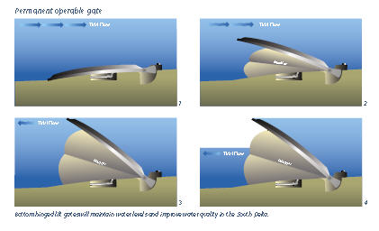
SDIP Permanent Gates Operation Rules
Action: “SET gate_elev (gate=……) TO …..”
Trigger: “chan_stage (chan=100, dist=0) < 0.0”

Slide 14
SDIP Permanent Gates Operation Rules
Working with the Operating Rules
Input file: Oprule_sdip_20090715.inp
OPERATING_RULE
Name → Action → Trigger
OPRULE_EXPRESSION
Name → Definition
OPRULE_TIME_SERIES
Name → Fillin → File → Path

Slide 15
Operating_Rule
Name:
orh_open (Head of Old River Open Position)
Action:
“SET gate_op (gate=old_r@head_barrier, device=weir, direction=from_node) TO OPEN RAMP 60MIN WHILE SET gate_op (gate=old_r@head_barrier, device=weir, direction=to_node) TO OPEN RAMP 60MIN”
Trigger:
“sjr_high OR a_winter OR a_summer OR (a_late_summer
AND (NOT orh_partial_sjr_flow))”

Slide 16
Oprule_Expression
Name → Definition
sjr_high → “ts(name=vernalis_flow) > ${SJR_HIGH_FLOW}”
a_winter → “SEASON > ${FALL_END} OR SEASON < ${VAMP_START}”
a_summer → “SEASON > ${VAMP_END} AND SEASON <= ${SUMMER_END}”
a_late_summer → “SEASON > ${SUMMER_END} AND SEASON < ${FALL_START}”
orh_partial_sjr_flow → “ts (name=vernalis_flow) > ${LO_ORH_PARTIAL_FLOW} AND ts (name=vernalis_flow) < ${HI_ORH_PARTIAL_FLOW}”

Slide 17
Oprule_Time_series
Name → Fillin → File → Path
Vernalis_flow → linear → ${BOUNDARYFILE} → /CALSIM-VAMP /C639/FLOW//1DAY/ ${CALSIMSTUDY}/

Slide 18
Configuration File
SJR_HIGH_FLOW → 10000.
FALL_END → 01DEC
VAMP_START → 15APR
VAMP_END → 16MAY
SUMMER_END → 16JUL
FALL_START → 01OCT
LO_ORH_PARTIAL_FLOW → 800.
HI_ORH_PARTIAL_FLOW → 2500.

Slide 19
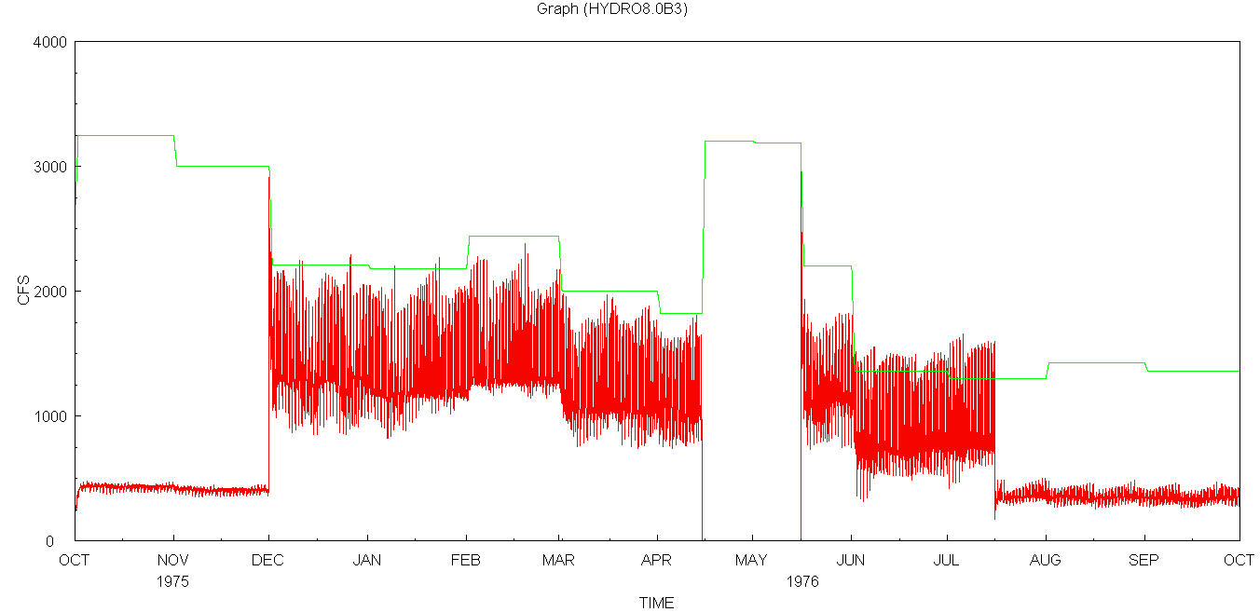
Flow at Old River d/s of Head of Old River Gate
Vernalis
d/s of gate
Fall
SJR>10,000; Open
SJR<10,000; Leaky 10%
Winter
Open
VAMP
SJR>10,000; Open
SJR<10,000; Close
Summer
Open
Late Summer
800<SJR<2,500;partially close

Slide 20
Operating Rule varying RAMP
Name:
orh_open (Head of Old River Open Position)
Action:
“SET gate_op (gate=old_r@head_barrier, device=weir, direction=from_node) TO OPEN RAMP 60MIN WHILE SET gate_op (gate=old_r@head_barrier, device=weir, direction=to_node) TO OPEN RAMP 60MIN”
Trigger:
“sjr_high OR a_winter OR a_summer OR (a_late_summer
AND (NOT orh_partial_sjr_flow))”

Slide 21
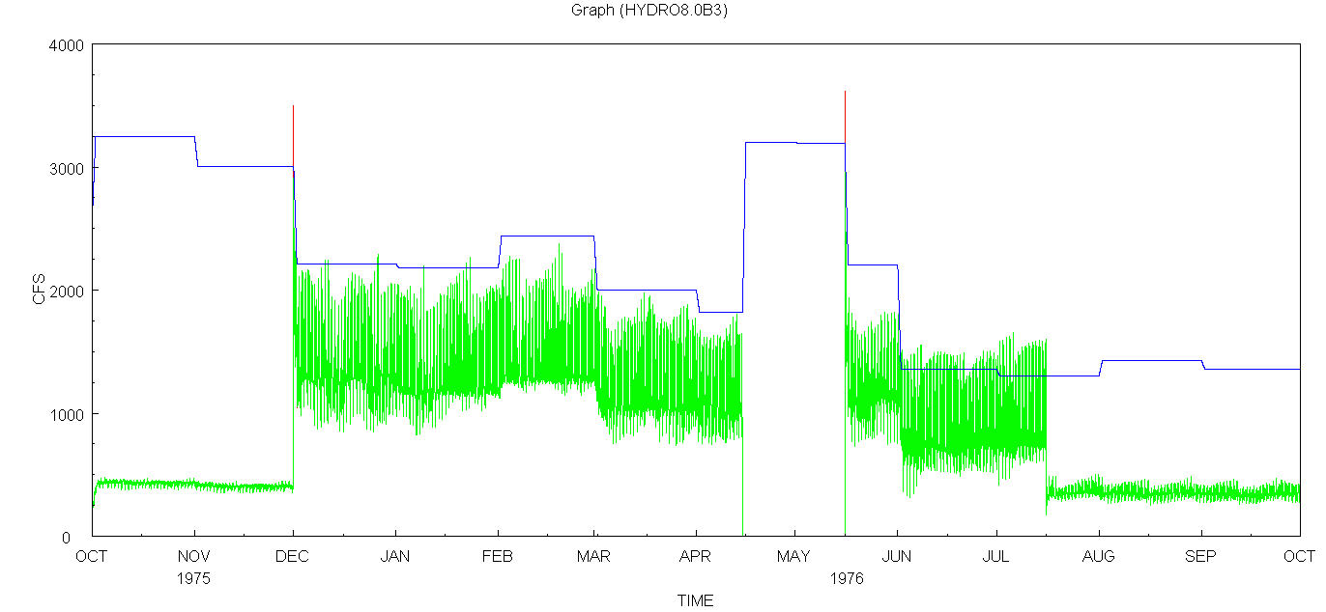
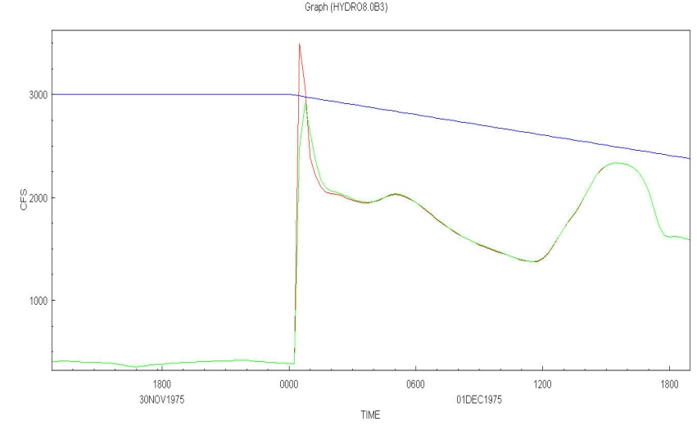
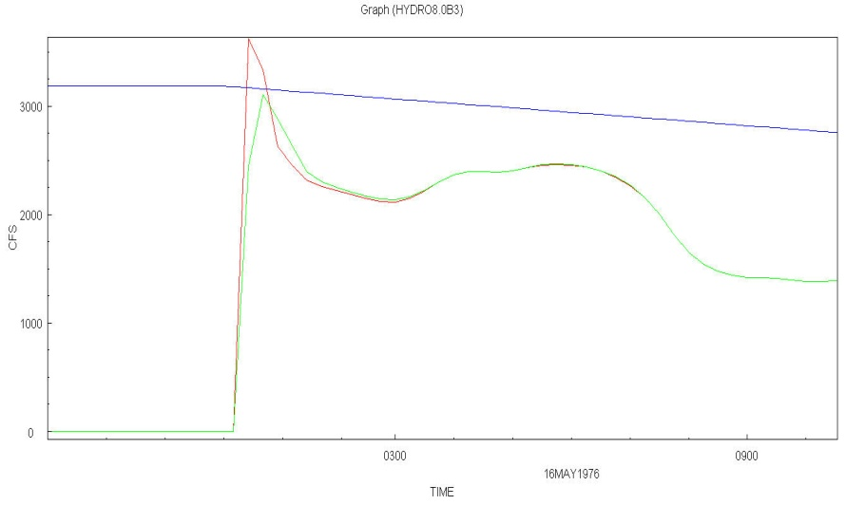
Flow at Old River d/s of Head of Old River Gate
with varying open RAMP
Vernalis
d/s of gate open RAMP 60 Min
d/s of gate open RAMP 30 Min
Fall
SJR>10,000; Open
SJR<10,000; Leaky 10%
Winter
Open
VAMP
SJR>10,000; Open
SJR<10,000; Close
Summer
Open
Late Summer
800<SJR<2,500;partially close

Slide 22
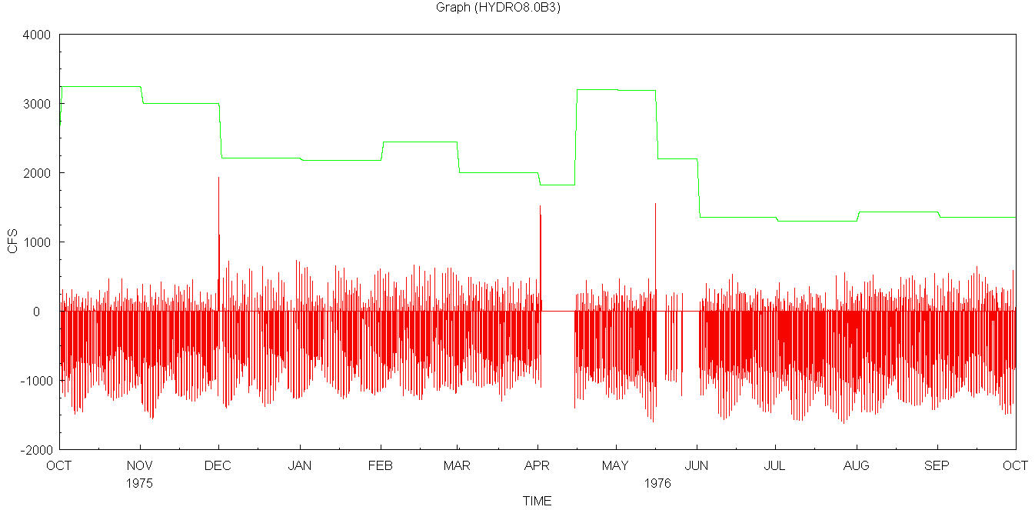
Flow at d/s of Middle River Gate
Vernalis
d/s of gate
Fall
SJR>10,000; Open
SJR<10,000; Leaky 10%
Winter
Open
VAMP
SJR>10,000; Open
SJR<10,000; Close
Summer
Open
Late Summer
800<SJR<2,500;partially close

Slide 23
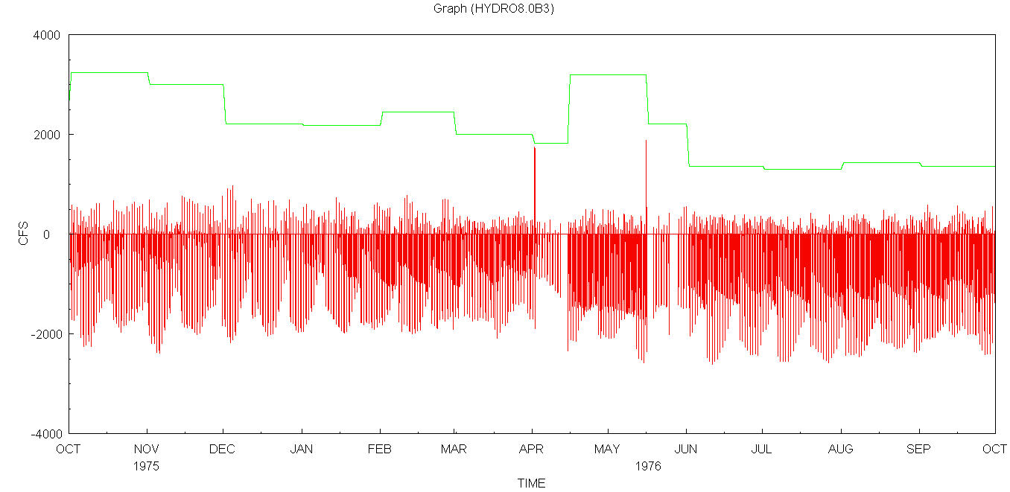
Flow at d/s of Old River Gate
Vernalis
d/s of gate
Fall
SJR>10,000; Open
SJR<10,000; Leaky 10%
Winter
Open
VAMP
SJR>10,000; Open
SJR<10,000; Close
Summer
Open
Late Summer
800<SJR<2,500;partially close

Slide 24
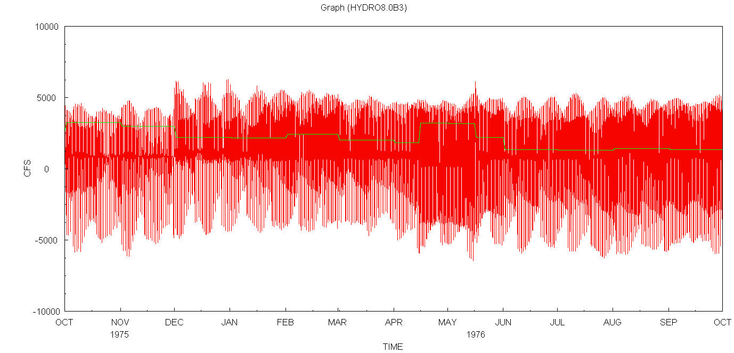
Flow at d/s of Grant Line Canal Gate
Vernalis
d/s of gate
Fall
SJR>10,000; Open
SJR<10,000; Leaky 10%
Winter
Open
VAMP
SJR>10,000; Open
SJR<10,000; Close
Summer
Open
Late Summer
800<SJR<2,500;partially close

